Slide 1

Copy Express Web to Print Potential Solution
Presentation by Helen James
For
http://www.eprintsoftware.com

Slide 2
Introducing ePrint
Modular cloud solution
Management Information System tailored for Print Shops
Business to Business eStore
Business to Customer eStore
ePrint eStore Editable Template Products
“Run your whole business workflow from one system linked to the accounting system of your choice.”
8 years in NZ, 5 in Sydney Australia
Phil Rutherford
Hexicom Software Pty Limited Unit 8, 37A King Road Hornsby, NSW 2077
Notes:
ePrint eStore Editable Template Products
This module works in either the B2B or B2C eStores. You are able to create products that your customers can review
Online and edit and proof before ordering.

Slide 3
MIS
Easy Estimates and print management
Create/ email estimates easily based on built in pricing.
Progress to job, linking the estimate to the job.
View all jobs or those at each phase, colour code.
Manage customers, control ownership of stored templates, upload specific templates and items to B2B websites.
Create and save reports (use filters and dates to customise).
Xero Application Programming Interface (API)

Slide 4
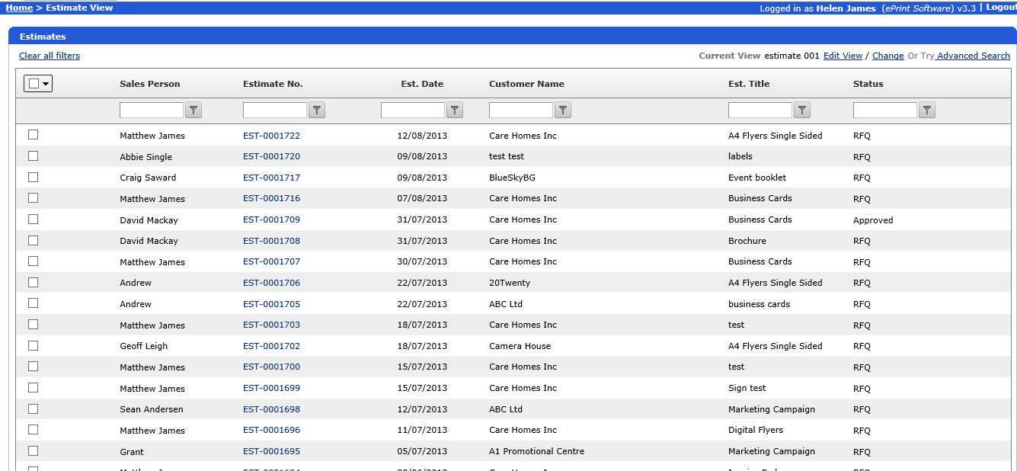
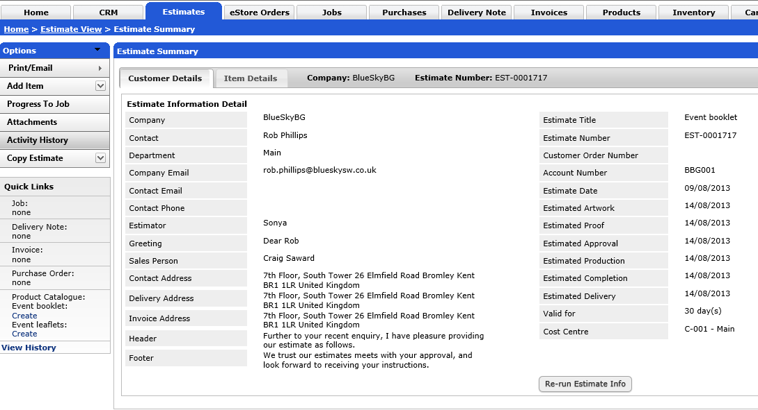
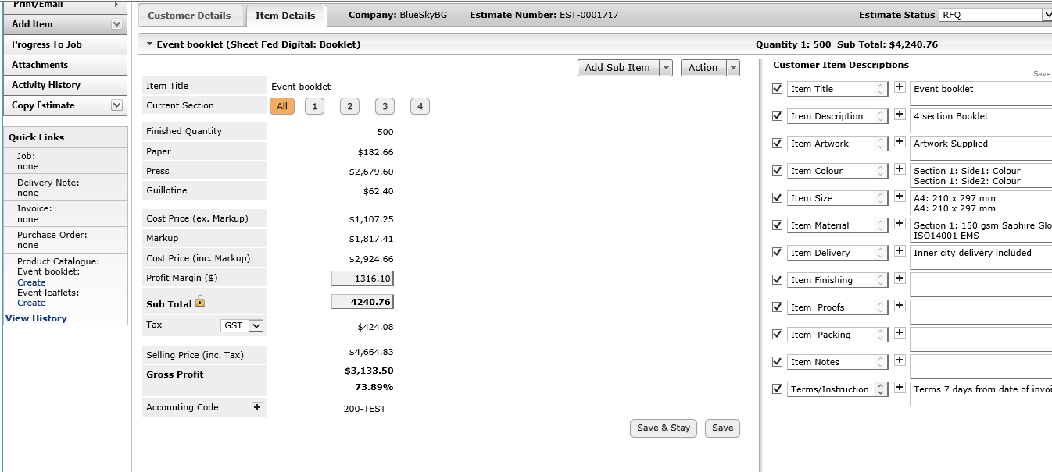
MIS - Estimates
Notes:
Progress to Job

Slide 5
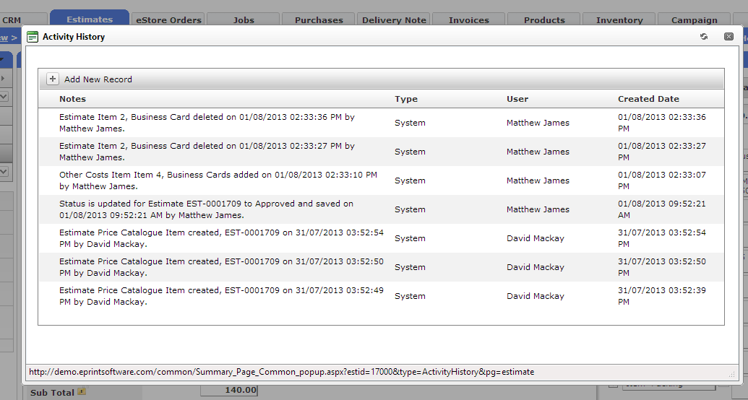
MIS - Estimates
Notes:
Activity History

Slide 6
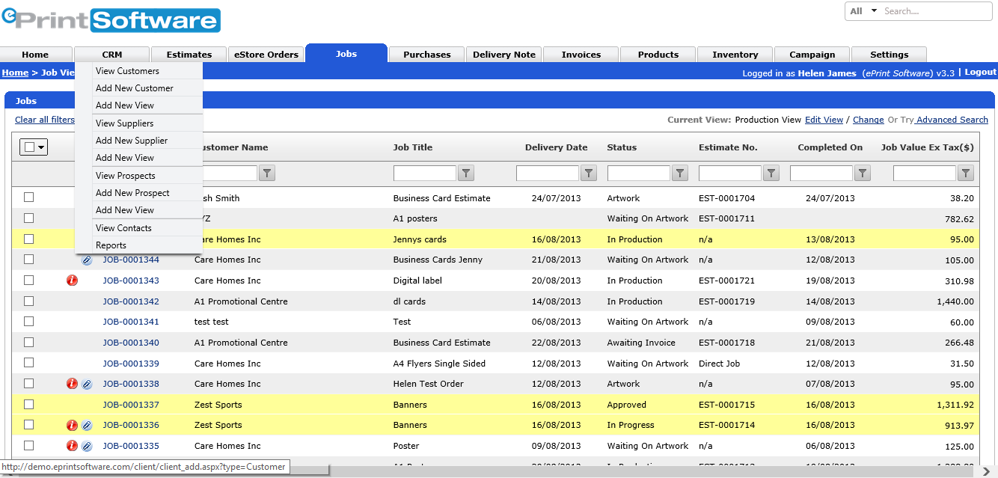
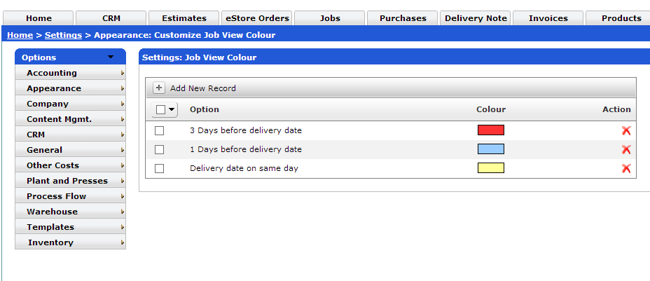
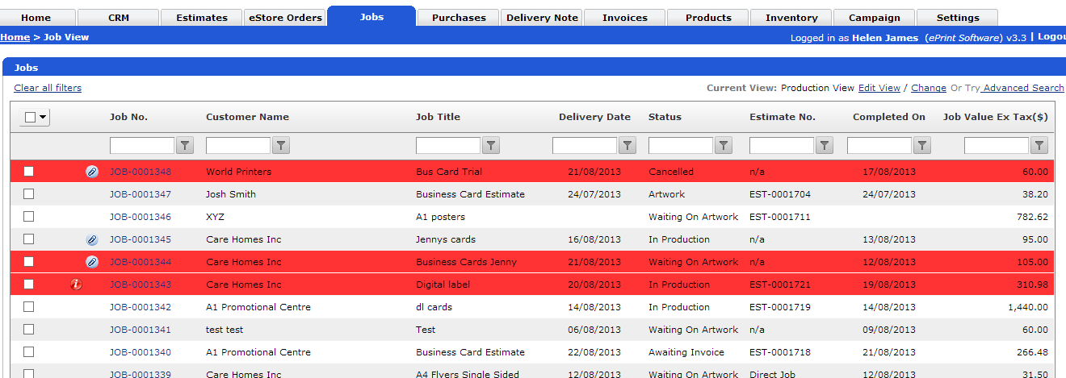
MIS - Jobs
Notes:
Jobs can be sorted by each of the filters

Slide 7
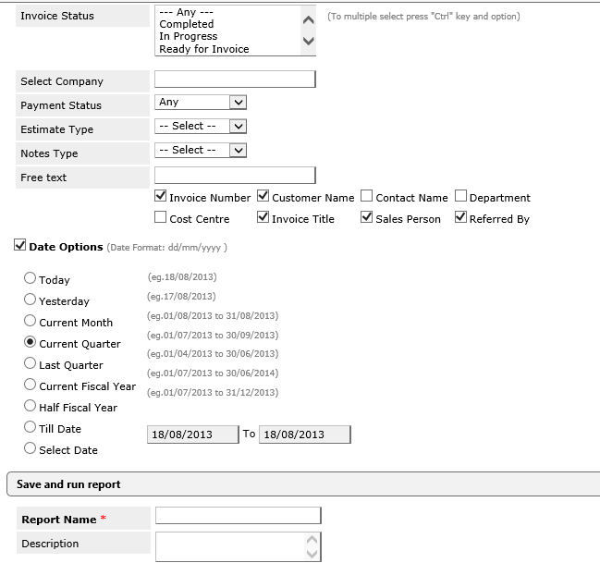
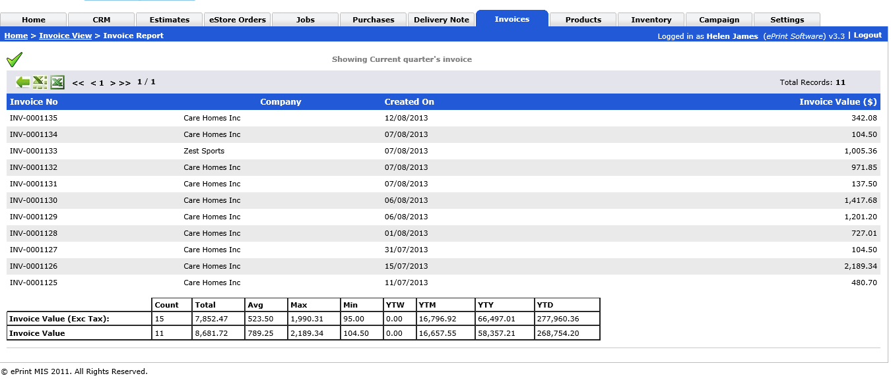
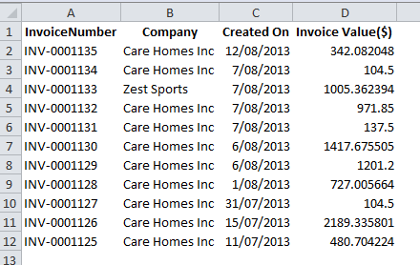
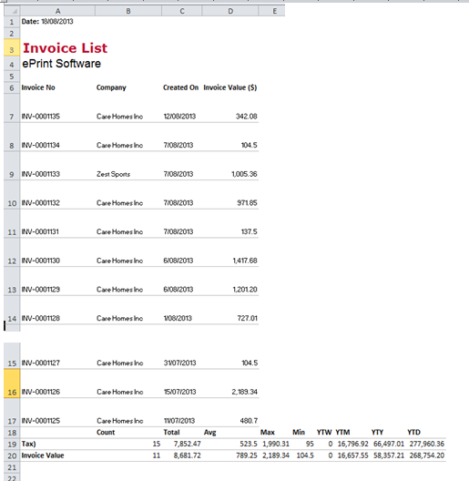
MIS -Reports
Notes:
Run an Invoice report – can export to excel for graph generation, in normal mode or presentation mode

Slide 8
B2B
There are three types of products you can create:
Fixed Artwork
Artwork Upload
Editable
Customised product choice
Add remove items to shopping cart
View previous orders
Reorder
Future viewing of quotes and proofs (next upgrade)
Notes:
There are three types of products you can create:
Fixed Artwork - these products have the PDF file for them already attached to the product. You add the artwork when you create the product so all the customer has to do is select the product, preview the artowrk if they wish and place the order. In this instance the products artwork never changes eg a letterhead for a corporate customer.
Artwork Upload - these are generic products where the customer uploads their own artwork each time they order.
Editable products - these are products where you provide a basic template and the customer can edit the text and add images and logos themselves as they wish. They can preview the finished design on screen before placing the order.

Slide 9
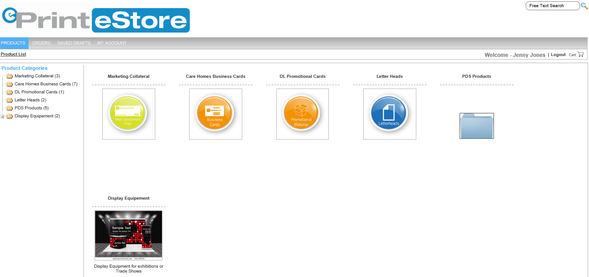
B2B- demo homepage
Notes:
ePrint demo, Actual print stores

Slide 10
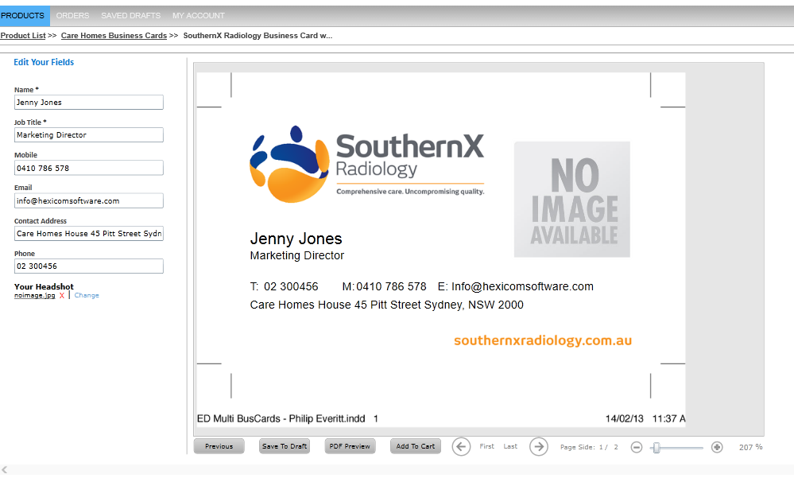
B2B-demo (logged in)

Slide 11
B2C
Artwork Upload
Editable products
View order history
Add/remove items from cart
Payment by credit card/ internet payment
Future reorder (under development)
Notes:
Artwork Upload - these are generic products where the customer uploads their own artwork each time they order.
Editable products - these are products where you provide a basic template and the customer can edit the text and add images and logos themselves as they wish. They can preview the finished design on screen before placing the order.

Slide 12
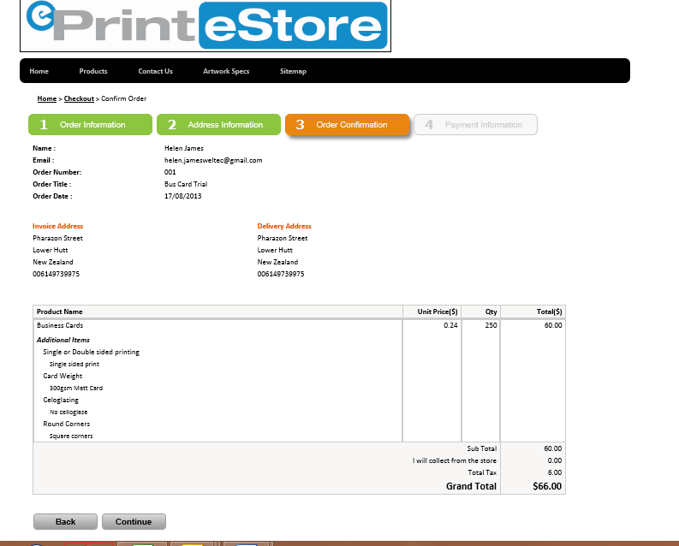
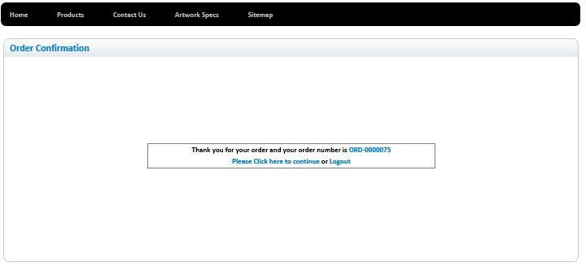
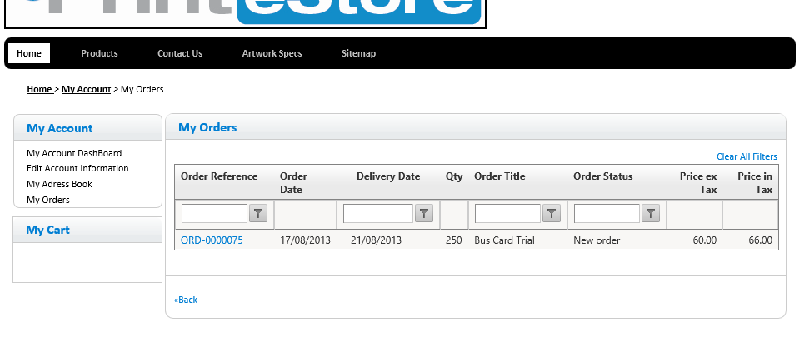
B2C

Slide 13
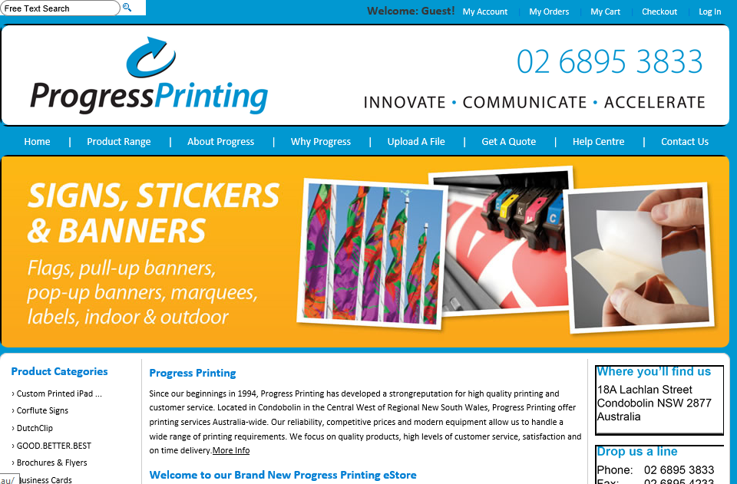
B2B/B2C-Live Print Website
www.progressprinitng.com.au
Notes:
Also; www.coralcoastprint.com.au

Slide 14
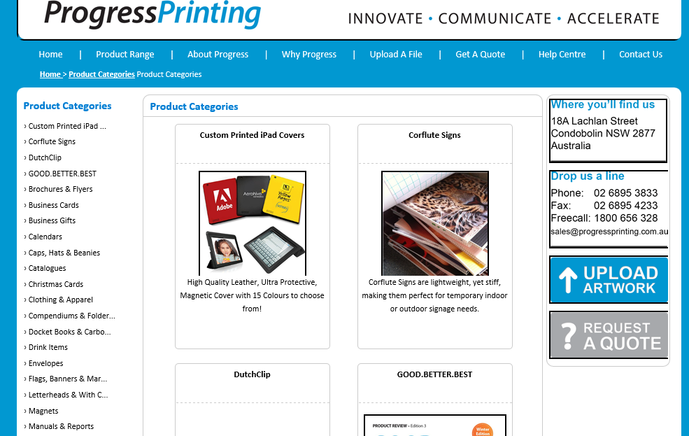
B2B/B2C-Live Print Website

Slide 15
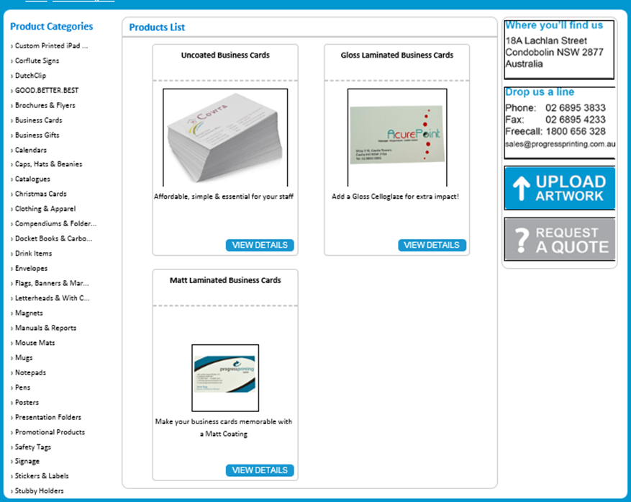
B2B/B2C-Live Print Website
Notes:
There are three types of products you can create:
Fixed Artwork - these products have the PDF file for them already attached to the product. You add the artwork when you create the product so all the customer has to do is select the product, preview the artowrk if they wish and place the order. In this instance the products artwork never changes eg a letterhead for a corporate customer.
Artwork Upload - these are generic products where the customer uploads their own artwork each time they order.
Editable products - these are products where you provide a basic template and the customer can edit the text and add images and logos themselves as they wish. They can preview the finished design on screen before placing the order.

Slide 16
Strengths
Specialised Print MIS, dynamically linked to eStores
API integration to Xero
Online database backed up daily
All future development included in monthly fee
New API that links with Mail Chimp, designed to enable you to send out customer email blasts offering specials and seasonal promotions etc. (links with the customer database in ePrint MIS.) Ready in next few weeks .
Excellent response time from Phil Rutherford
Covers 81% of Functional requirements
Covers 73% of General requirements
Notes:
Customer logs in, gets an email places an order..it automatically goes in the

Slide 17
Weaknesses
No JDF (Job Definition Format) output
API to Mail Chimp does not allow for automated reminders
Websites a little unprofessional looking???
No surveys on website, but can email them out
Limited self design capabilities (no libraries supplied)
Online proofing promised to come, but not yet
Need to raise a negative invoice for a cancelled job to credit their account.
Paper ticket

Slide 18
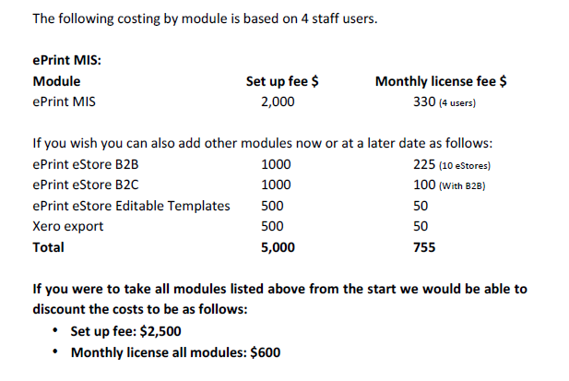
Cost

Slide 19
Links
ePrint MIS Web address: http://demo.eprintsoftware.com/Default.aspx Email: helen.jamesweltec@gmail.com Password: password (in lower case)
Example B2B eStore Web address: http://demo.eprintsoftware.com/store/accounts/login.aspx?id=8 Email: info@hexicomsoftware.com Password: password (in lower case)
Example B2C eStore - this one is currently under construction http://demo.eprintsoftware.com/store/public/
Email: helen.jamesweltec@gmail.com Password: Printer1

